Slide 1
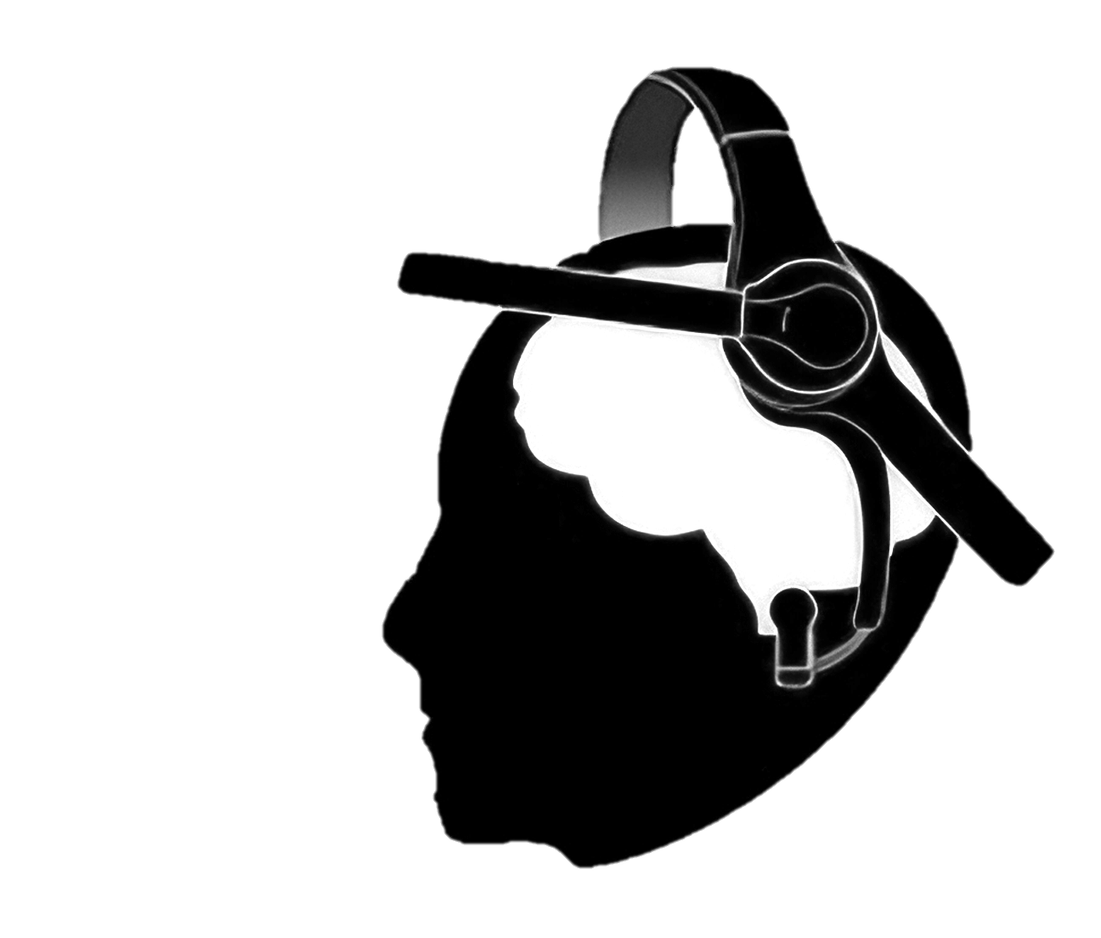


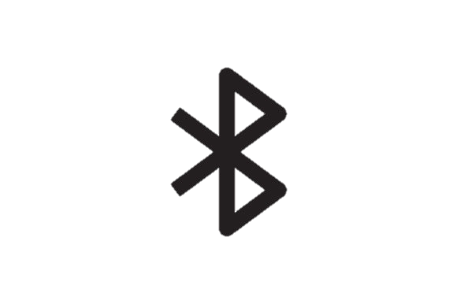




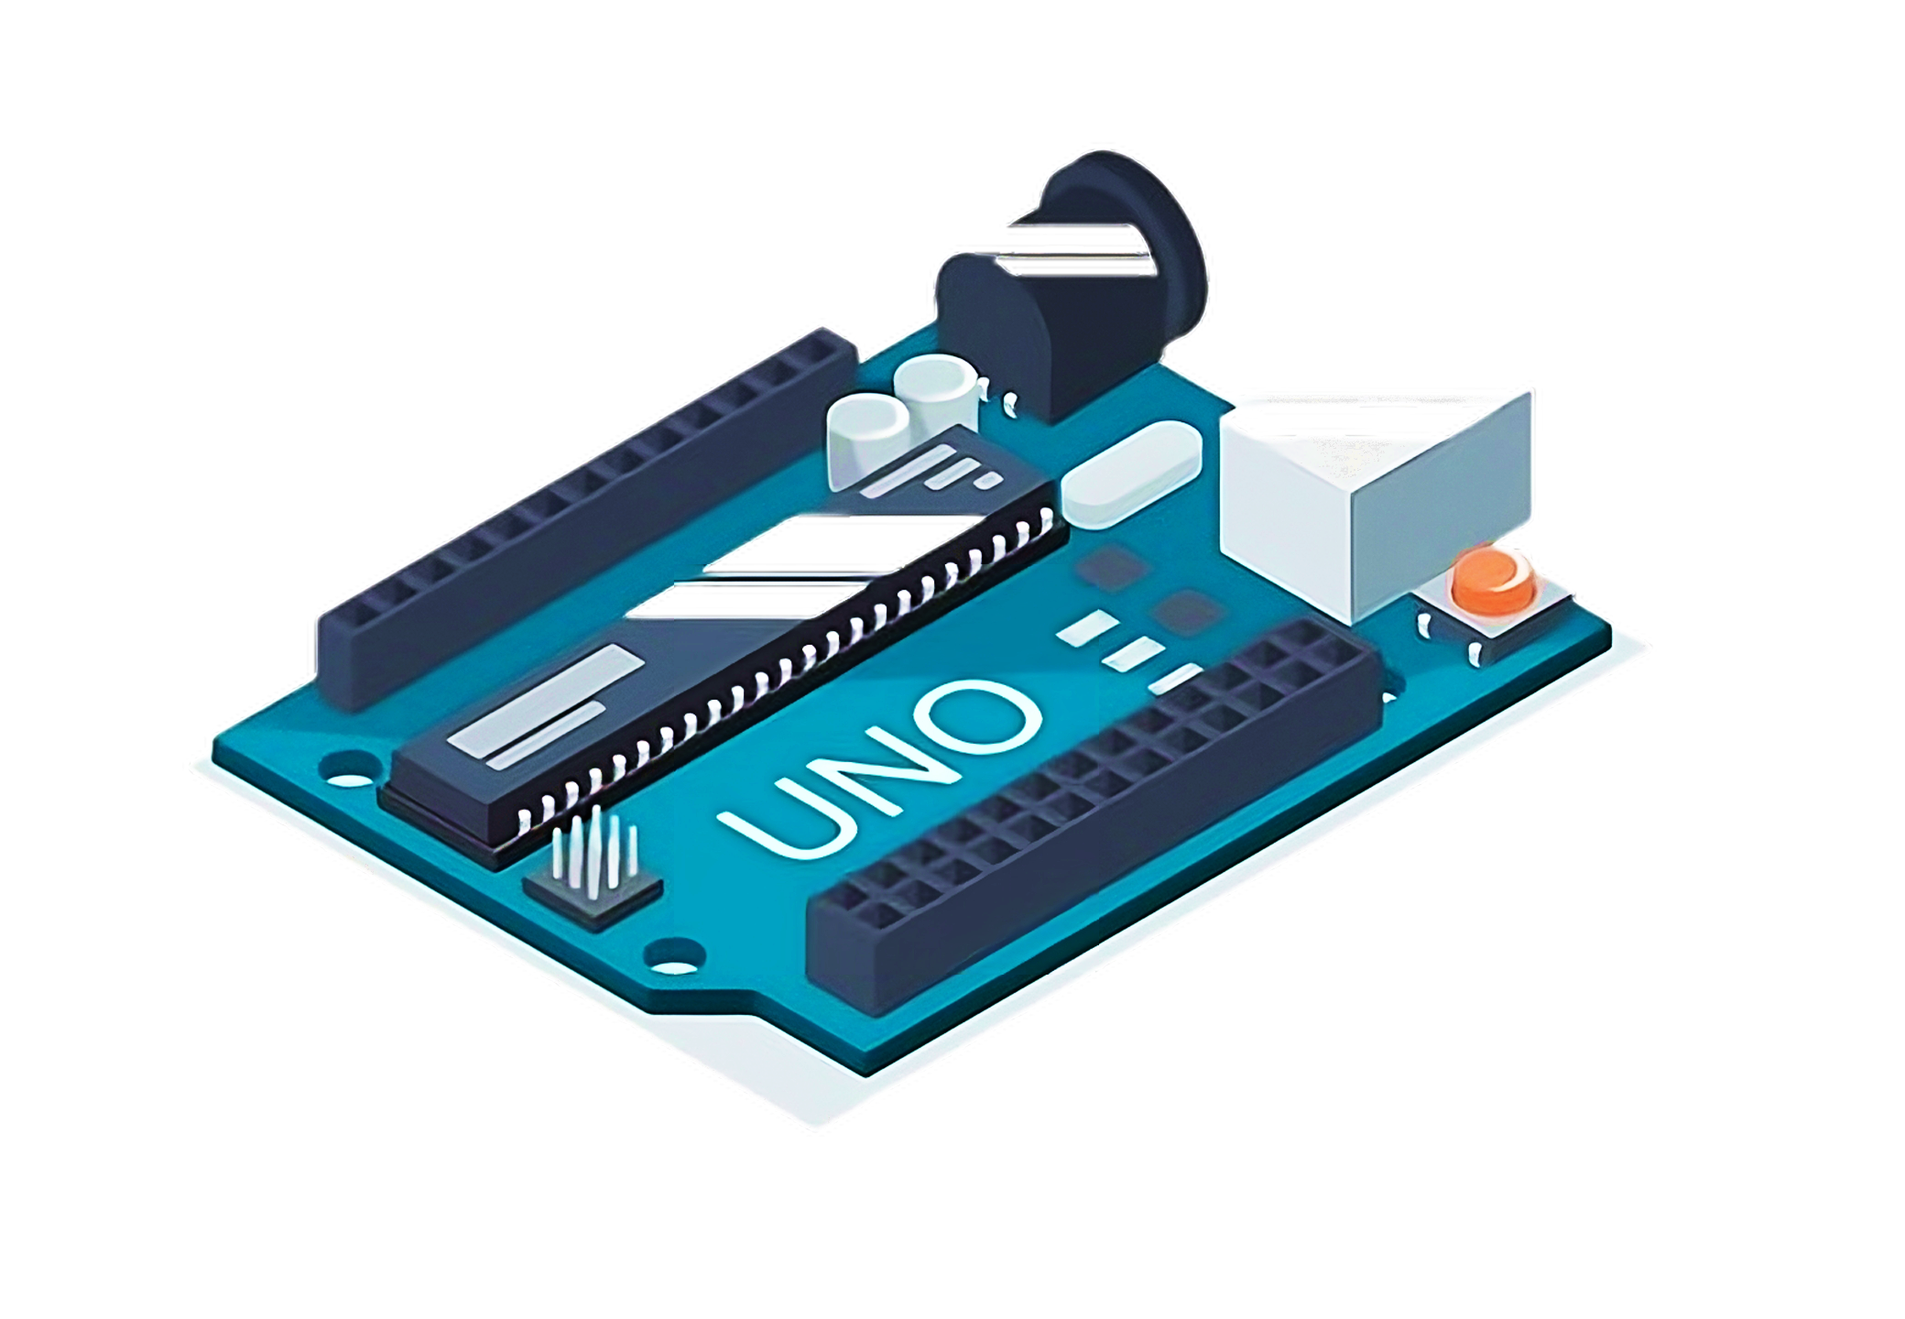
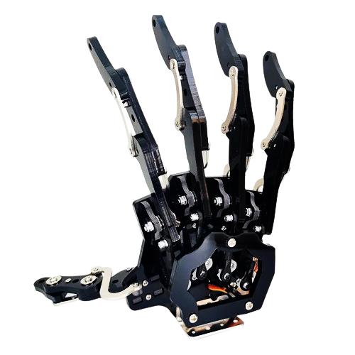






Mind-Controlled Robotic Arm Using Wearable EEG Headset
Mind-Controlled Robotic Arm Using Wearable EEG Headset
Mind-Controlled Robotic Arm Using Wearable EEG Headset
Rithvik Praveen Kumar
Software Developed
Westborough High School
C++ Arduino program (Arduino board)
Python controller program (laptop)
Objectives
Code
Develop a prototype of a brain-computer interface.
Design a mind-controlled robotic arm using EEG headset
Aim to bridge communication barriers among individuals with different abilities.
Demonstrate the capability to mind control basic movements of the robotic arm within the project scope.
Explore future applications for disabled individuals, allowing them to control the robotic arm using their mind.
Investigate the feasibility of translating intentions into sign language gestures through the robotic arm.
https://github.com/rithvikpkx/MindControlRoboticArm
Materials and Software Used
NueroSky Mindwave Mobile 2 EEG Headset
Arduino UNO microprocessor
Arduino IDE
ThinkGear SDK by NeuroSky
Robotic arm with individual finger servo motors
Solderless wires
Breadboard
Miscellaneous materials for construction
Laptop/PC
Abstract
The EEG Headset reads brain waves and communicates to the computer via Bluetooth
The MindReader program running on computer receives this EEG data
The MindReader program is designed and developed to process and detect blink and attention data from the raw EEG data
The program then connects to the microprocessor (Arduino board) via the COM port of the computer and sends commands (1 to 5 or 99)
The Arduino code, HandController in the microprocessor is designed and developed to move the robotic hand based on the commands received from the MindReader program running on the computer
Commands 1 to 5 is mapped to showing the respective number of fingers on the robotic hand
Command 99 is mapped to make a sinusoidal wave motion on the robotic hand
Conclusion / Future Considerations
With more in-depth and accurate brainwave data and with potentially using AI to interpret the raw brain signals, this brain-computer interface can be extended to achieve a greater extent of communication between differently abled individuals, ( Ex : ASL)
Usage
Blinks
The user wears the headset
They then blink a few times
Watch the robotic hand show the number of blinks
The user then can concentrate their minds on any object
Observe the hand move in a wavy pattern
Attention

